Slide 1

Chakravyuh 2.0
Final Judging Presentation
Project Title : Ghost-Free Vault
Team Name: UG ENGINEERS™
Team Members: PREM, PRANAV, AKHILESH, SAMARTH
Department Of First Year- General Engineering

Slide 2
🚀 Problem Statement:
In the modern digital economy, consumers face "Subscription Fatigue," where small, recurring "ghost" payments for forgotten services accumulate into significant annual financial waste.

Slide 3
🛰️ Proposed Solution:
THE SOLUTION:
Privacy-First Design: 100% Local Storage based. Your financial data never
touches a server.
Automated Math: Instantly converts monthly costs into "Yearly Waste" to
trigger psychological action.
Kill-Date Countdown: A dedicated field for the exact date you must cancel,
prioritized in the UI.
Zero Budget/Zero Friction: No account creation required to start; works
instantly on any browser.

Slide 4
Zero-Friction Entry: No accounts or logins; immediate utility upon opening.
Psychological Pivot: Shifts focus from "cheap monthly" to "expensive yearly" spending.
Local-First Logic: Uses local Storage for persistence without external servers.
Minimalist Efficiency: Solves one problem (subscription fatigue) without feature bloat
🛰️ Innovation and Uniqueness:

Slide 5
Frontend: HTML5/CSS3 (Responsive UI).
Logic: Vanilla JavaScript (Calculations & DOM updates).
Storage: Web Storage API (local Storage) for data persistence.
Process: User Input → JS Logic → Local Persistence → UI Render.
🧩 System Architecture:

Slide 6
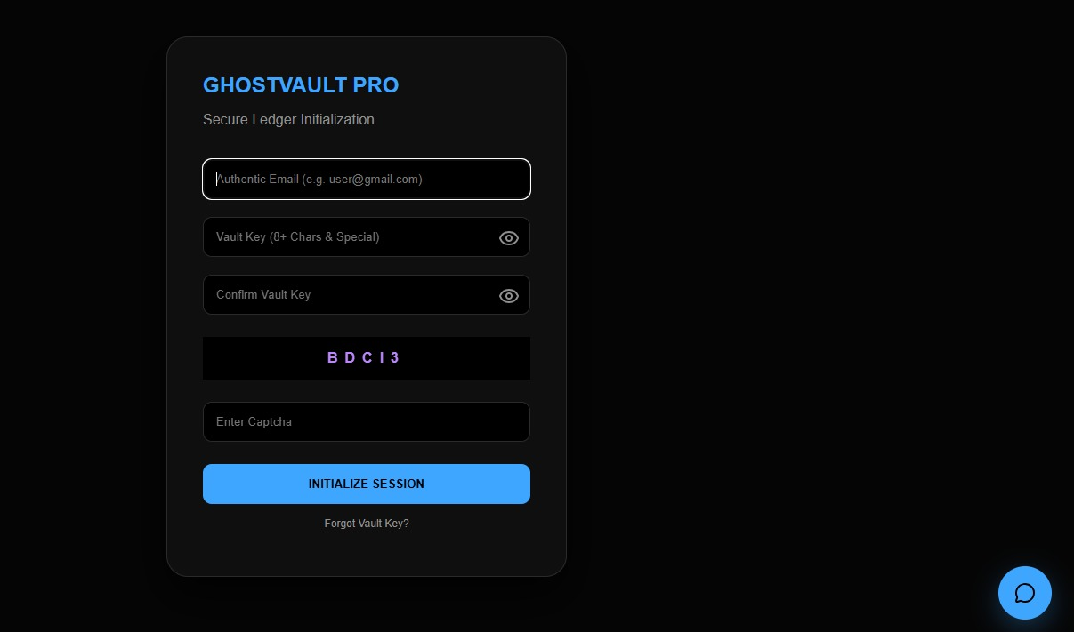
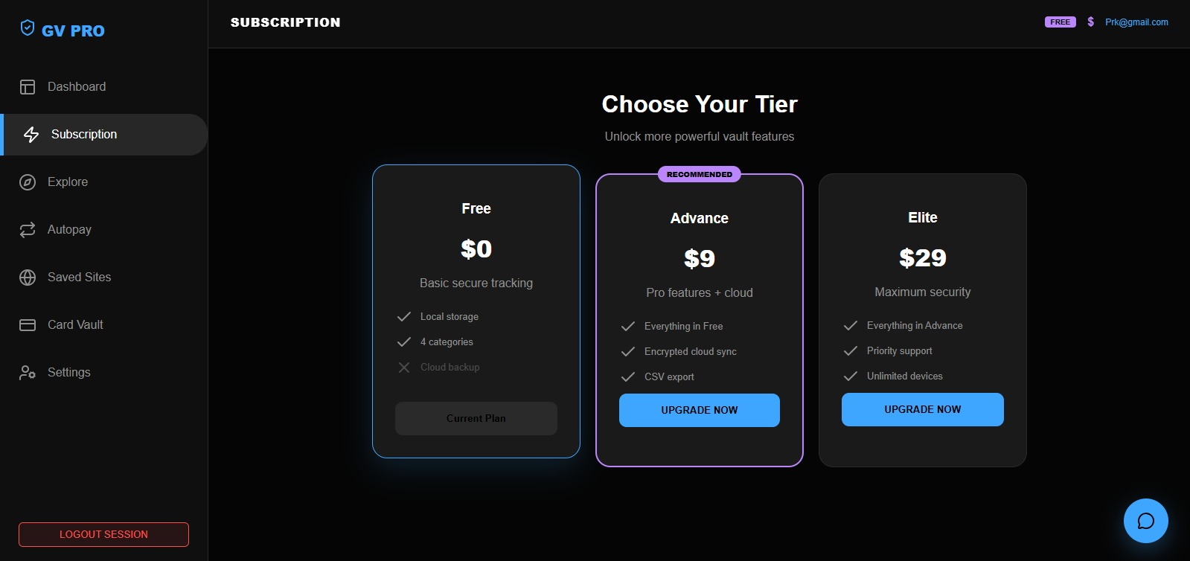
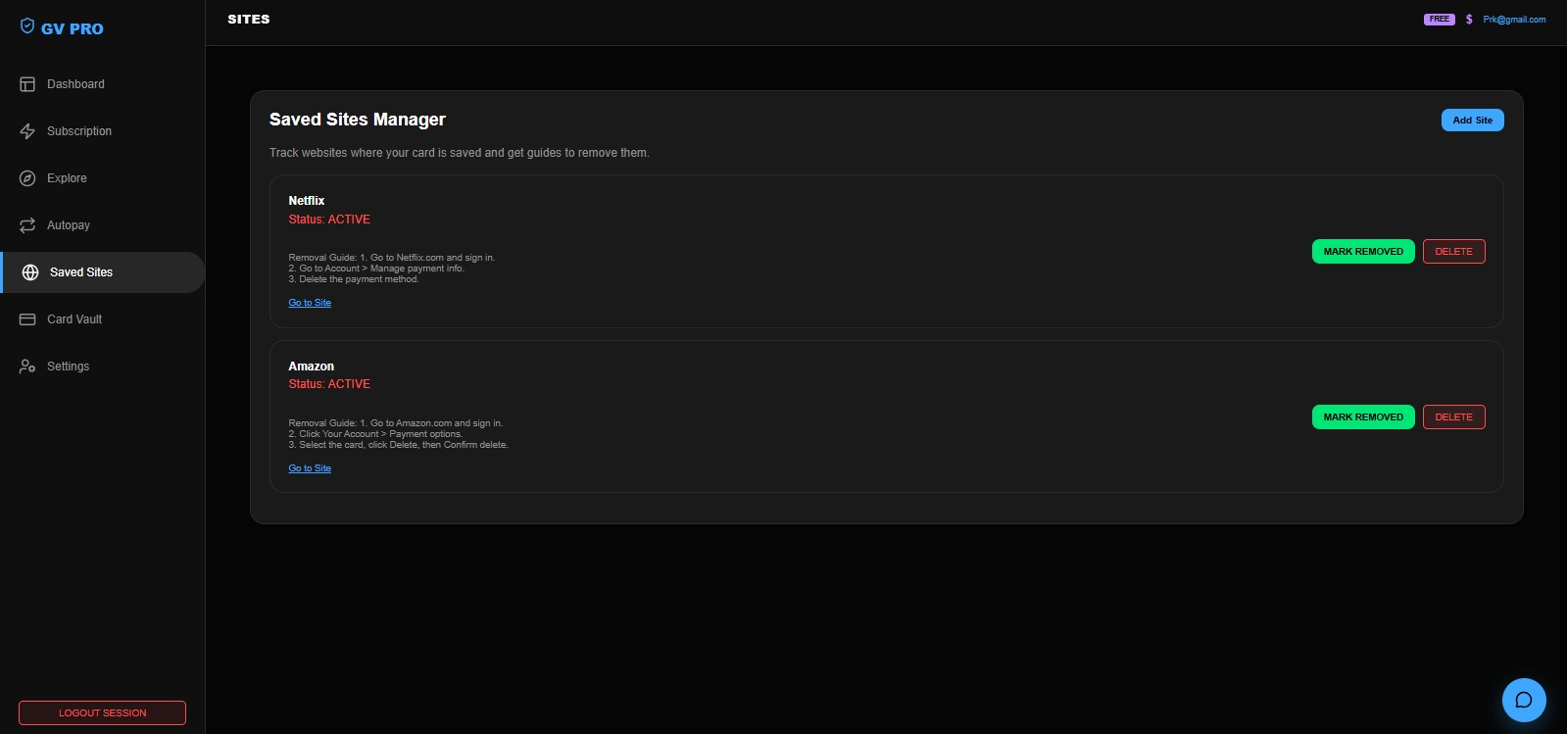
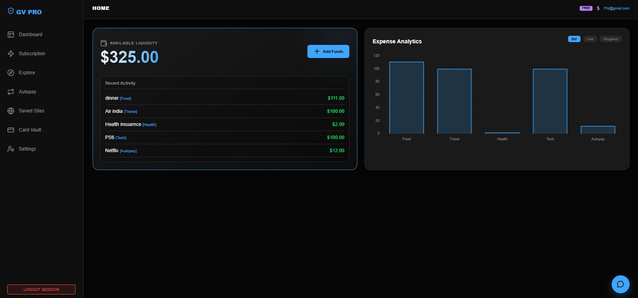

Slide 7
🌍 Impact & Benefits:
Financial Awareness: It actively stops the "silent drain" on your wallet by forcing you to log and look
at your recurring expenses.
Long-Term Perspective: By automatically calculating your "Estimated Yearly Waste"
(your monthly costs multiplied by 12), it reveals the true, often surprising, annual cost of small
subscriptions.
Centralized Tracking: It acts as a single, organized "vault" to see exactly where your money is going
every month.
Persistent Memory: Because it uses your browser's local storage (local Storage), it remembers your
subscriptions even after you close the page, serving as a reliable long-term tracker.
Easy Maintenance: The simple "Remove" function lets you quickly update your budget the moment
You decide to cancel a service.

Slide 8
Cloud Integration: Move to NoSQL (Firebase/MongoDB) for multi-device sync.
Automation: Integrate Plaid API for real-time bank transaction fetching.
AI Insights: Machine learning to predict price hikes and suggest cancellations.
Extensions: Browser plugin to detect and log "Free Trials" automatically.
📈 Scalability & Future Scope:

Slide 9
Thank You

